Slide 1
Executive Summary
We are building a product that is easy to use and also serve multiple needs
We believe that the machine we are making will serve farmers needs and also curb the post harvest losses of vegetables that the farmers are currently facing which will increase their income and the standards of living.
Also the dried vegetables after being sold to the NGOs they will be taken to the hunger stricken areas, which means the rate at which malnutrition diseases affects these people from this areas will go down

Slide 2
Vision
Create our market demand and growing awareness among farmers and NGOs
Our product must never lose nutrients
At first, we have to capture our market within 1/2 years
We will start selling our drying machines to the farmers in 3years
Mission
Our mission is to provide the highest-quality dried vegetables. We also focus on providing:-
Finest quality of our products
Keeping the prices of our products reasonable
Providing best customer service
Goals
Increase new customers who are turned into long term customers
Maintain positive steady growth each month
To enter into a new market
Generate brand equity at the farmers market

Slide 3
Economic overview
As the world population and the demand for food continue to grow, global food security characterized by the accessibility, usability, and availability of food is becoming increasingly threatened by an array of factors, including the worldwide expansion and changing dietary preferences of the middle class, urbanization, diminishing natural resources, food price volatility, and inefficient labor and land use (WHO n.d.). Despite these challenges, the Food and Agriculture Organization of the United Nations ascertains that our planet has the capacity to sustain the expanding global population. Many farmers incur losses during postharvest .Many places where drought is prominent people are affected by Malnutrition diseases.
Primary data on the stressors was collected from detailed interviews with 30 farmers, vendors, from various parts of Kenya. Understanding which models are the most resilient to the various stressors would allow entrepreneurs to compare models and make more informed decisions about which models are most appropriate for their technologies. Most of these vegetables sold in open markets appeared fresh but were sold from poor environmental conditions. At times because of poor handling, their qualities were perceived to be poor, an issue that discouraged many potential buyers from consuming these products. The most commonly sold traditional leafy vegetables in Nairobi were Jute (‘mrenda’), Crotalaria (‘mito’), Solanum (‘osuga’/’managu’), Spider plant (‘saget’), Amaranth, pumpkin leaves, and African kale. The survey was conducted during the hot months (February/March) and therefore most of the vegetables were not available in large quantities.
Lastly, this technology being cheap and effective should be transferred to the local communities and women groups for preservation of seasonal vegetables like cowpeas. Together with it, the promotion for increased acceptability and consumption of the fermented and dehydrated vegetables should be done among the rural communities, where the deficiency of vitamin A and iron is likely to be rampant during the drought The most applicable method of drying includes freeze, vacuum, osmotic, cabinet or tray, ﬂuidized bed, spouted bed, Ohmic, microwave and combination thereof except for freeze drying, applying heat during drying through conduction, convection and radiation are the basic techniques used to force water to vaporize, while forced air is applied to encourage the removal of vapor. A large number of food and biomaterials are dehydrated in a variety of units with diverse processing conditions. The choice of drying method depends on various factors such as the type of product, availability of dryer, cost of dehydration and ﬁnal quality of desiccated product. Energy consumption and quality of dried products are other

Slide 4
Economic overview
As the world population and the demand for food continue to grow, global food security characterized by the accessibility, usability, and availability of food is becoming increasingly threatened by an array of factors, including the worldwide expansion and changing dietary preferences of the middle class, urbanization, diminishing natural resources, food price volatility, and inefficient labor and land use (WHO n.d.). Despite these challenges, the Food and Agriculture Organization of the United Nations ascertains that our planet has the capacity to sustain the expanding global population. Many farmers incur losses during postharvest .Many places where drought is prominent people are affected by Malnutrition diseases.
Primary data on the stressors was collected from detailed interviews with 30 farmers, vendors, from various parts of Kenya. Understanding which models are the most resilient to the various stressors would allow entrepreneurs to compare models and make more informed decisions about which models are most appropriate for their technologies. Most of these vegetables sold in open markets appeared fresh but were sold from poor environmental conditions. At times because of poor handling, their qualities were perceived to be poor, an issue that discouraged many potential buyers from consuming these products. The most commonly sold traditional leafy vegetables in Nairobi were Jute (‘mrenda’), Crotalaria (‘mito’), Solanum (‘osuga’/’managu’), Spider plant (‘saget’), Amaranth, pumpkin leaves, and African kale. The survey was conducted during the hot months (February/March) and therefore most of the vegetables were not available in large quantities.
Lastly, this technology being cheap and effective should be transferred to the local communities and women groups for preservation of seasonal vegetables like cowpeas. Together with it, the promotion for increased acceptability and consumption of the fermented and dehydrated vegetables should be done among the rural communities, where the deficiency of vitamin A and iron is likely to be rampant during the drought The most applicable method of drying includes freeze, vacuum, osmotic, cabinet or tray, ﬂuidized bed, spouted bed, Ohmic, microwave and combination thereof except for freeze drying, applying heat during drying through conduction, convection and radiation are the basic techniques used to force water to vaporize, while forced air is applied to encourage the removal of vapor. A large number of food and biomaterials are dehydrated in a variety of units with diverse processing conditions. The choice of drying method depends on various factors such as the type of product, availability of dryer, cost of dehydration and ﬁnal quality of desiccated product. Energy consumption and quality of dried products are other

Slide 5
critical parameters in the selection of a drying process. To reduce the use of fossil fuel, electrical energy is an alternate source of energy for drying applications especially where electricity is generated by a renewable energy source such as hydro power or wind power. Keeping these in view, the present review is focusing on recent developments in drying and dehydration and future scope for better drying. Malnutrition due to nutritionally inadequate diets is one of the major concerns in Kenya and many other developing countries. The vegetables are rich in vitamins especially A, B, and C, and minerals such as iron, zinc, calcium and phosphorus, thus helping curb malnutrition mostly in hunger stricken areas.

Slide 6
PRODUCT
Being in a country that has one of its major concerns as fighting malnutrition mostly in hunger stricken areas because the relief food from the government doesn’t contain all the nutrients required by the body, we decided to come up with a solution to the problem that we validated from the research we did by interviewing farmers and also vegetable vendors, which is building a hardware product that will be used to dry surplus vegetables from farmers to reduce post-harvest losses of their vegetables. After drying these vegetables we plan to package them in 500g plastic bags then deliver/sell them to NGOs so that they can be distributed to the hunger-stricken areas with the aim of providing a balanced diet to curb malnutrition. Our product will be able to meet different needs at the same time as our customers requested which is:-drying more than one farm produce at the same time with regulated temperatures, which after drying the farm produce will retain the same percentage of nutrients as fresh produce from the farm.
The hardware machine will be powered by solar. Using a solar panel, the power will be then transferred to batteries that have an adapter to convert energy. The power will be supplied to Arduino, then the Arduino transfers power to the fan. The hardware machine will also have temperature humidity sensor that measures the temperature to remain moderate for vegetable drying. This ensures that the temperature remains 150F - 180F.When the temperatures are higher than the maximum the fan is automatically turned on. This is to allow the temperatures to remain moderate to ensure that the vegetables don’t lose their nutrients.
The vegetables will be picked from the farmers and packed carefully in crates neither too tight nor too loose in two bunches stalks facing different sides. The vegetables will then be weighed, loaded to our trucks then transported to our warehouse. After vegetables from different farmers arrive at the warehouse they will be offloaded then weighed again just to confirm that the weight given at the farm level is still intact. The vegetables will then be sorted and graded then weighed again according to their different grades, After which we will now engage in washing them clean and putting them in the machine for drying. After drying we will package the vegetables in 500g plastic bags then according to orders we deliver the vegetables to the respective NGOs.

Slide 7

After three years of successful business running, we intend to start selling our machines to groups of farmers in large scale vegetable farming areas and train them on how to operate the machine, after which they will be doing the drying on their own but we will also be offering machine service at a cost. We will also link the farmers with the NGOs we will have worked with just to make sure we do not add extra tasks to the farmers of getting the market for their dried vegetables.
Our customers are the NGOs, we plan on partnering with the farmers first then make then our future customer. So the farmers will be helping us get the product that the NGOs want which is vegetables then we will be making the vegetables available to the NGOs in the form that will meet their needs.
OUR PRODUCT MOCKUP

Slide 8
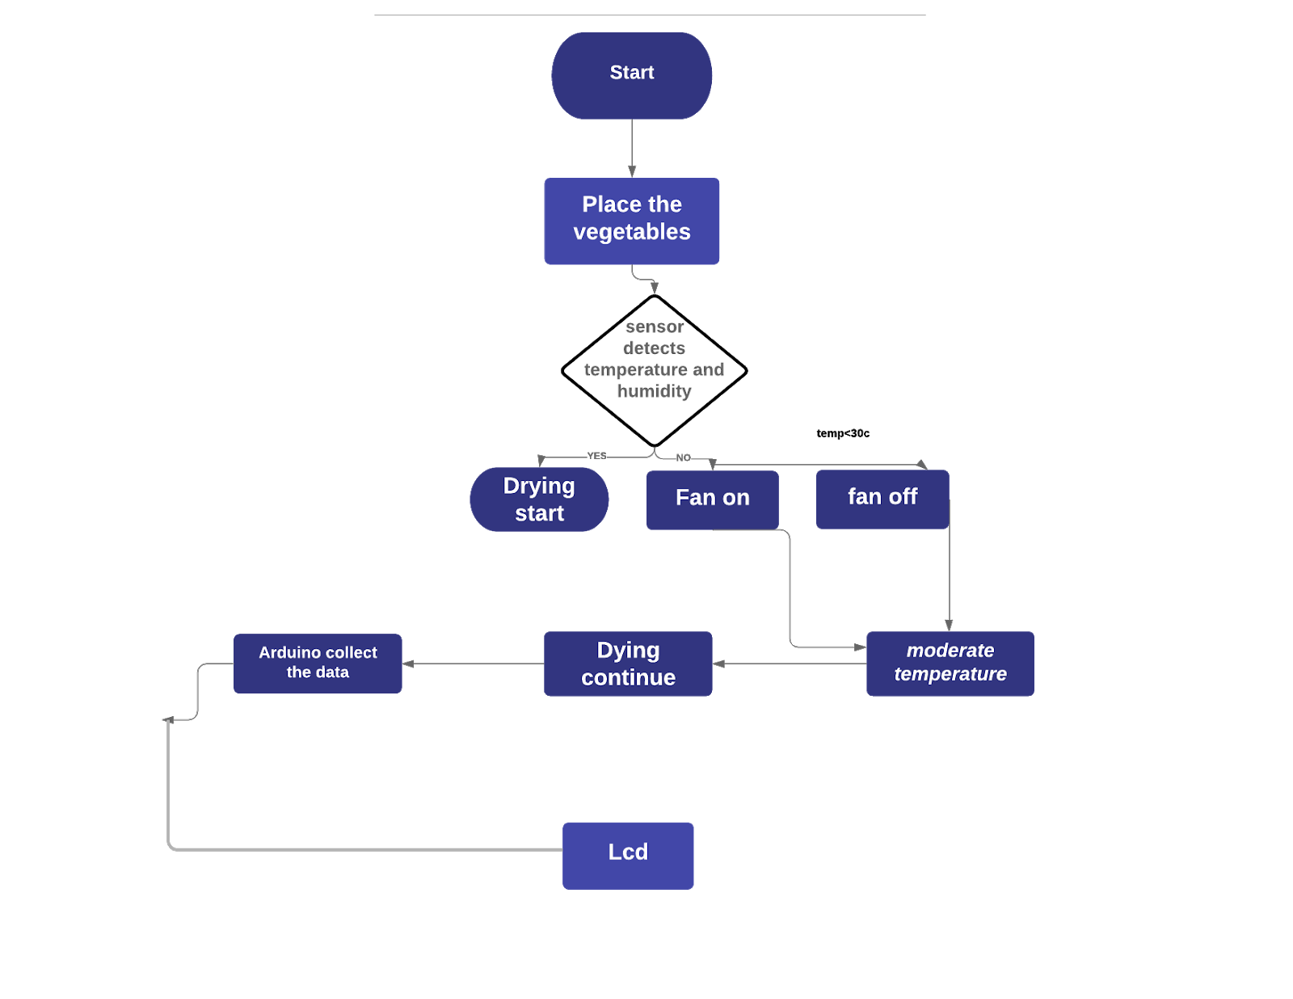
Flowchart

Slide 9
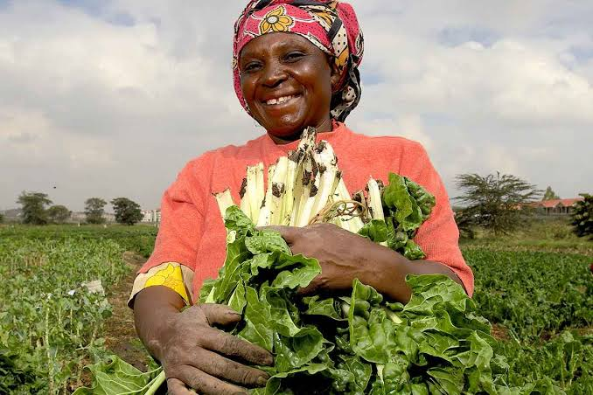
Market research & analysis
Name: Hellene Jana,
Age: 43,
Occupation: Full-time farmer,
Location: Kahuho,
No. of Employees: 2­­­­­ ,
Income: KSH 50,000,
Farm size:3 acres,
Type of farming: Mono-crop farming
Children:4
No of cows:2
Annual Expenditure on the farm: 400,000
Goal: "To provide for her family and ensure they are well educated”

Slide 10
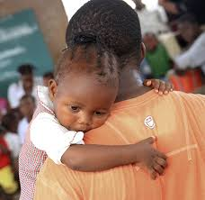
Persona 2
Name: Akothee Foundations ,
Location: Nairobi,
No. of Employees: 15,
Existence:1years,
Goal: "lets make a difference in people's lives.”

Slide 11
MARKET RESEARCH
To have a better understanding of our customer we developed a persona. Our personas’ name is Helen. Hellen is a 43 years old woman located in Kahuho area and owns a 3 acre land that she plants vegetables and sells them to vegetable vendors for income because being a single mother,she has to provide for her kids. During vegetable surplus season Hellen gets so many vegetables That some end up becoming cows food. Helen also leaves her vegetables to rot in her farmer in times of surplus.
We have one confirmed NGO customer, Akothee foundations. We made a call at Akothees office and she confirmed that they really need vegetables in large quantities to supply in Turkana as it has been the company’s’ goal to provide food that not only makes the people full but also a meal that contains all the nutrients needed by the body.
Our customer number will grow by us marketing ourselves and also making sure that we deliver exactly what we promise to deliver or even better. This will b so if we the right procedure of drying our vegetables and making sure we do not exploit our customers.
We have several companies that are trying to solve the same problem we are solving but we have decided to settle with JKUAT as our competitors because they make the drying machine they use and they sell it to the farmers for drying the vegetable which is our future plan. They also dry vegetables on their own but the problem is they cannot dry small quantities because their machine is the size of a greenhouse thus making it expensive
For farmers to purchase.JKUAT sells one machine 600,000 at Kenyan shillings. Their machine is also not convenient because it requires to be operated manually. The advantage they have is that the machine uses solar meaning electricity cannot inconvenience the farmers while drying and also the machine is huge thus drying a large number of vegetables and saving time. Through the work we have done developing the machine, and also the pricing of our products that is the drying machine and the dried vegetables, we have managed to influence Akothee Foundations and also several farmers to be part of our brand as we start
We are certain that the customers we will start with are long term customers because we will have the best customer services and also our product will serve multiple needs at a time which is dying different types of vegetables a service our competitor don’t offer. And also our drying machine will be designed with the user in mind from the start. Which means it will be easy for the farmer to operate.

Slide 12
Marketing Plan
Overall marketing strategy and main marketing channels
The mission of the company is to control the vegetable losses that farmers face. As a result, product life cycles may be quite short. Single-sourcing can be detrimental or even fatal to a company if the buyer supplier relationship is damaged or if the supplying company has financial difficulty. Competition from traditional paper calendars and other promotional items is strong.
Matching strengths to opportunities/ Converting weaknesses and threats.
Marketing Channels
1.Advertising through promotional items relies on gadgetry and ideas that are new and different.
2.Use of flyers to advertise the product.
3.Creating a website and enabling a Google Analytic plugin.
-This is to track the amount of people that login to the site and view its content.
4.A blog that will explain more about the product.
5.Partnering with the companies that do the same thing to help advertise the product to the market.
6.Having social media adds that enhance traffic to our sites.
7.Use Facebook click.
8.The use of social media influencers like chefs that advertise the value of the product.
9.Launching videos that give the explanation of a product and how it works and the nutritional value.
10.Pay for sections in supermarkets to be on top shelves.
-Hire a person to advertise for the product and give a price comparison with the competitors.

Slide 13
Previous successful marketing strategies
1.The use of social media influencers like chefs that advertise the value of the product.
2.Launching videos that give the explanation of a product and how it works and the nutritional value. 3.Partnering with the companies that do the same thing to help advertise the product to the market.
-The product will be able to reach the customers by attending summits that allows them to test the products and give offers to the customers.
4.Pay for sections in supermarket to be on top shelves and hire a person to Advertise for the product and give a price comparison with the competitors.
Pricing
By determining the sales of our competitors e.g.: Sundried sell indigenous vegetables at ksh.350 per 100g.
When the surplus is bulky, approximately buying vegetables worth ksh.50 will result in 2kg of these vegetables. Advertising promotion The company will use Informative advertising to give people the basic in formation about the product what it does and demonstration showing different ways in which the product is used .This will enable to capture interest, raise awareness, leave a positive impression, and motivate people to take the next step, like making a purchase or requesting more information about the product.
Creating segmentation on the market that enable user and customers to have bonus When buying or producing different quantity of vegetables. This will motivate the customers to produce more product an maintain growth. Paying an influencer to influence people to change brands, or motivate people to make a purchase. This might show the benefits a product offers or compare key features against a leading competitor.
Having a reminder to reassures people who already know and potentially like a brand, with a goal of keeping the product or service top-of-mind for future purchases. It reinforces messages from other ads, and may include customer testimonials.

Slide 14
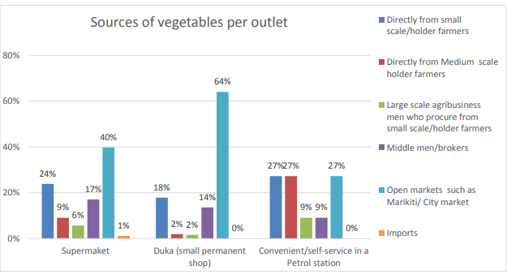
Sales statistics

Slide 15
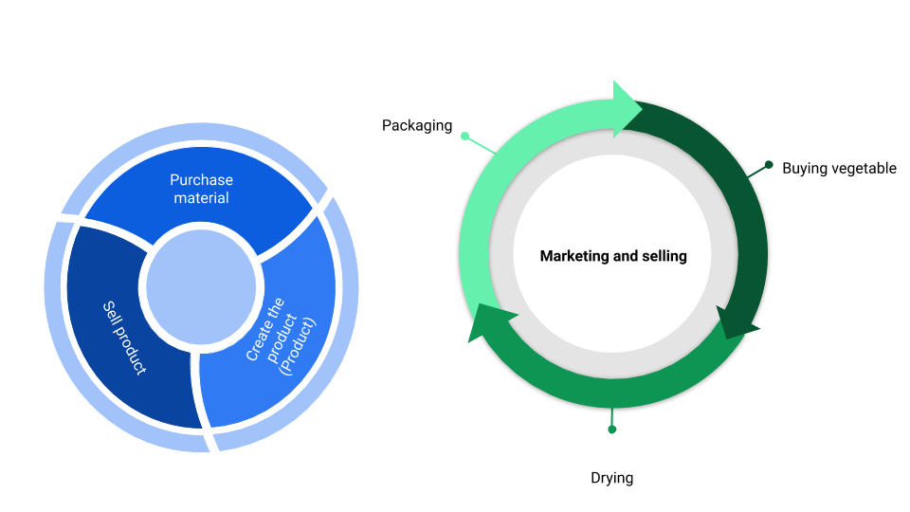
Operations Plan

Slide 16
Regulatory and legal issues
Searching business name | KSh 50
Registering a business | Ksh 2,500
licence | Ksh 10,000
Place of incubation | Ksh 90,000

Slide 17
Facilities needed for operations
Computer
3D printer
2 Table
Office space
Fusion
Illustrator ,Photoshop Xd,
Electronic components

Slide 18
Operations Plan
Health insurance
•General Liability and Property Insurance
•Compensation Insurance
•Liability Insurance
•Business Income Insurance helps replace lost income if you must temporarily shut down your business because of a covered incident.
Employment contracts are not only a legal necessity, they can also help set the tone of your business. They are a great way to set out clear expectations for the employer and employee, laying the foundations for a mutually rewarding relationship. An employment contract should cover key areas such as pay, benefits, hours, holiday, sickness and termination.
Confidentiality agreement(No-Disclosure Agreement)
An NDA is the first step to protecting your ideas and intellectual property when sharing confidential information with other individuals or businesses. It is the easiest and most common way of ensuring that this information is not made public or exploited in any way. It also means that in the eventuality of any breach of contract, you can take legal action to implement any solution needed to rectify or prevent further breaches and recover damages.
Partnership agreements
•Avoid potential conflict when you enter into a partnership by having in place a detailed and complete partnership agreement of what is expected from each of the partners and how the business will be run under the new partnership. This document should cover who the partners are, their rights and responsibilities, and what will happen if and when they decide to leave the partnership.

Slide 19
Health and safety policy
If you have five or more employees, you are required to have a written Health and Safety Policy. Not only does having one demonstrate that you are a responsible employer, it also gives staff the confidence that they are working in a safe environment, protecting them from injury and you from liability.
Letter Before Action
Good cash flow is essential for a successful and healthy business but late payment from customers and other businesses is something that is becoming more prevalent. If they are late in paying your invoice, send a formal late payment reminder letter and a follow-up second late payment reminder letter for any stragglers. If this fails to have the desired effect, send a letter before action – this final demand letter will demonstrate to a court that you have offered all reasonable measures to settle the debt before you commence legal proceedings.

Slide 20
TEAM
Proficient in python, JavaScript, Html /CSS, C++
•Work with data
•Debugging skill
•Creativity to enable improve the company value
•Finance manager (manages all the financial of the company and ensure all the money is spent well)
•BSc in Finance
•1year experience
•Fluent in English and Kiswahili
Quality assurance
Ensure the product is viable for the market
Staff planning
Board of advisors
Barre Yassin
John Owour
Kellie murungi

Slide 21
PROPOSED COMPANY OFFERING Section 8
1. Desired Funding
a) Radio trade board for agricultural commodities.
Technologies that enhance food availability and consumer education ease logistical challenges for farmers, vendors, and consumers and, in turn, increase the efficiency of FVCs. (Food Value Chain)
b) Grants
e.g.: Funding Information - East Africa Food and Nutrition Grants
2. Funding Structure
1.Partnership
3. Governance Post Funding
a) Investment Fund
An investment fund is a way of investing money alongside other investors in order to benefit from the inherent advantages of working as part of a group.
These advantages include an ability to:
· Hire professional investment managers, which may potentially be able to offer better returns and more adequate risk management;
· Benefit from economies of scale, i.e., lower transaction costs;
· Increase the asset diversification to reduce some unsystematic risk.
-May be held by the public, such as:
· Mutual fund,
· Exchange-traded fund,
· Special-purpose acquisition company or closed-end fund,^{[1]}

Slide 22
-Or it may be sold only in a private placement, such as:
· Hedge fund
· Private equity fund
-The term also includes:
· Specialized vehicles such as collective and common trust funds, which are unique bank-managed funds structured primarily to commingle assets from qualifying pension plans or trusts

Slide 23
CRITICAL RISKS AND MITIGATION
1.Risk of being thrown out of the business by the existing businesses which means to retain our business we must keep up with the developments in our field and also maintain good relations with our customers.
2.Quality risk –The potential that we will fail to meet our quality goal for the product we are creating, services to our customers and business practices to avoid this we will keep ourselves on toes and try to adopt with the customer taste and even better the expectations of our customers
3.Resourse risks – The chance that we will fail to meet our business goals due to lack of resources such as financing to reduces this we will make sure that every cash we get in the business is put to use for the purpose of profit and also we will make sure we create good relations with our customers to make them long term customers.
4.

